Slide 1
Chapter 8: Motion in Real and Virtual Worlds
Saurabh Verma

Slide 2
Definitions
Velocity – How fast an object is moving in a direction (∆y/∆t)
Finds change in y over time
Acceleration – How is the Velocity changing (dv(t)/dt)
Varies over time
Vection – Body movement sensation that is produced by visual stimulation

Slide 3
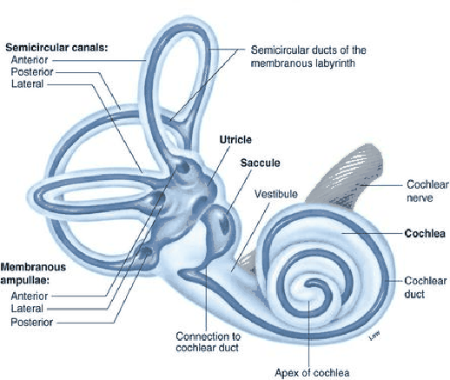
Vestibular System
Vestibular Organ
Informs brain of head orientation
Usually neglected, which results in mismatch of perceptual cues

Slide 4
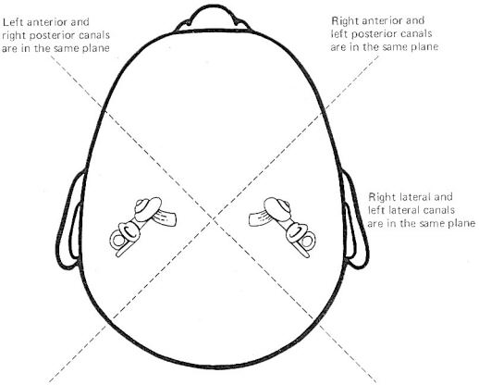
Vestibular System (continued)
Vestibular organs reside behind ears
Two symmetric organs (right and left sides)

Slide 5
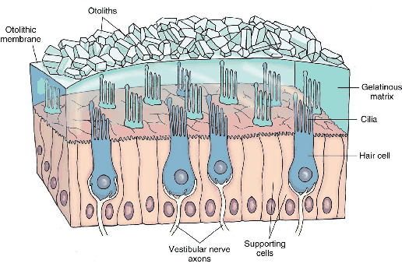
Vestibular System (continued)
Otolith Organ
Cilia – hair cells
Senses Acceleration → Neural signals

Slide 6
Vestibular System (continued)
Einstein Equivalence Principle
Body cannot distinguish between the effects of actual linear acceleration and gravity

Slide 7
Physics in the Virtual World
Physics engines determine state of virtual world
At any given point of time
Make it available to the rendering system
Body models use 244 degrees of freedom and 630 muscles
Runge-Kutta Integration
“Estimate y for given x”

Slide 8
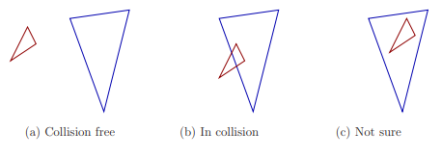
Collision Detection
Difficult in virtual worlds
If boundary, collision
If inside, collision?
Euclidean Distance

Slide 9
Mismatched Motion and Vection
Inverse relation between between headset’s FOV, latency etc. and Vection
Vector Field
Velocity Vector every point along the surface

Slide 10
Vection Types
Yaw
Pitch
Roll
Lateral
Vertical
Directional
Notes:
Yaw - Counterclockwise rotation about Y axis cause right-to-left movement
Pitch - Counterclockwise rotation causes downward movement
Roll - Counterclockwise rotation about optical axis causes features to rotate clockwise
Lateral - Translating viewpoint results in horizontal feature movement
Vertical - Upward translation causes downward flow
Directional - Translating viewpoint along optical axis away causes inward feature flow

Slide 11
Factors that affect Sensitivity
Percentage of Field of View
Distance from Center View
Exposure Time
Spatial Frequency
Contrast
Other Sensory Cues
Prior Knowledge
Attention
Prior Training/Adaption
Notes:
Percentage of Field of View - Increased FOV projects to larger region of Retina, which increases vection
Distance from Center View - Length of distance may impact vection
Exposure Time - Quick exposure period results in no vection
Spatial Frequency - Complicated virtual world causes visual feaetures to increase and optical flow to be stronger
Contrast - High levels cause features to stand out
Other Sensory Cues - Weakened by cues consistent with real world (e.g. fan blowing face)
Prior Knowledge - Knowledge ahead of time will affect onset of vection
Attention - User is distracted
Prior Training/Adaption - Body will learn to distinguish vection from true motion and eventually become comfortable

